Slide 1
Learning languages through a project in biology
M. Lacouture,
Lycée Le Dantec, Lannion, FRANCE
1
2
3
4
5
New tools to commu-nicate (LINO) with school & parents
School exchange program
Meeting in Lake district with a german school
webTV at school
ERASMUS+ project with partners in GER, ČSR, ISL, POR
International meeting in the Azores
IPads
Geolocalized drafts
GPS navigation, etc.
Contest for the best news reporting

Slide 2
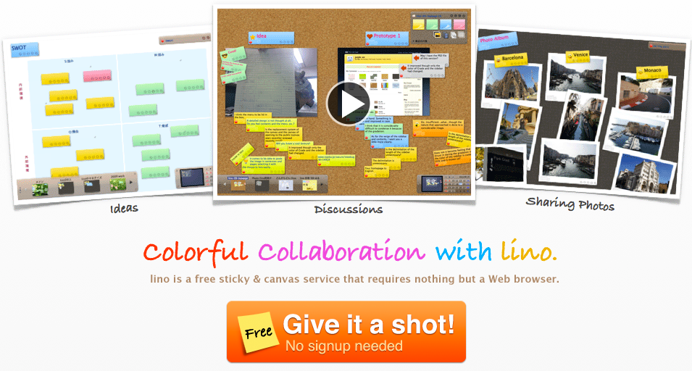

Slide 3
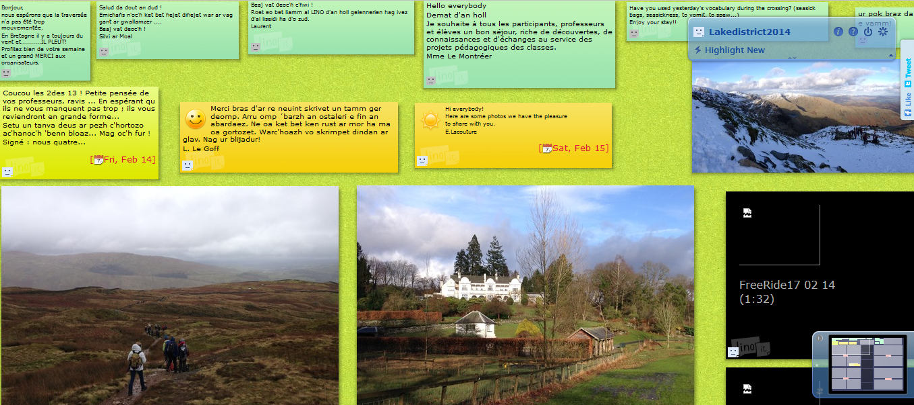

Slide 4
